Slide 1




ARVIND PATEL
Contact
Portfolio Management Service (PMS) - Performance Analysis & Insights
Investment Growth & Client Performance Overview
Presented by
Nitya Patel

Slide 2

Introduction to PMS
ARVIND PATEL
What is PMS?
A service where professionals manage investments for clients.
Focuses on personalized wealth growth.
Suitable for HNIs, entrepreneurs, and high-value investors.
How PMS Differs from Mutual Funds?
Customization:
PMS: Highly customizable investment strategies based on individual investor preferences, risk appetite, and financial goals.
Mutual Funds: Standardized investment portfolios where all investors in the same fund receive identical allocations.
2. Return Potential:
PMS: Offers potentially higher returns as fund managers have flexibility in selecting stocks and can actively manage portfolios.
Mutual Funds: Returns are relatively moderate as funds follow a predefined investment strategy and regulatory constraints.

Slide 3
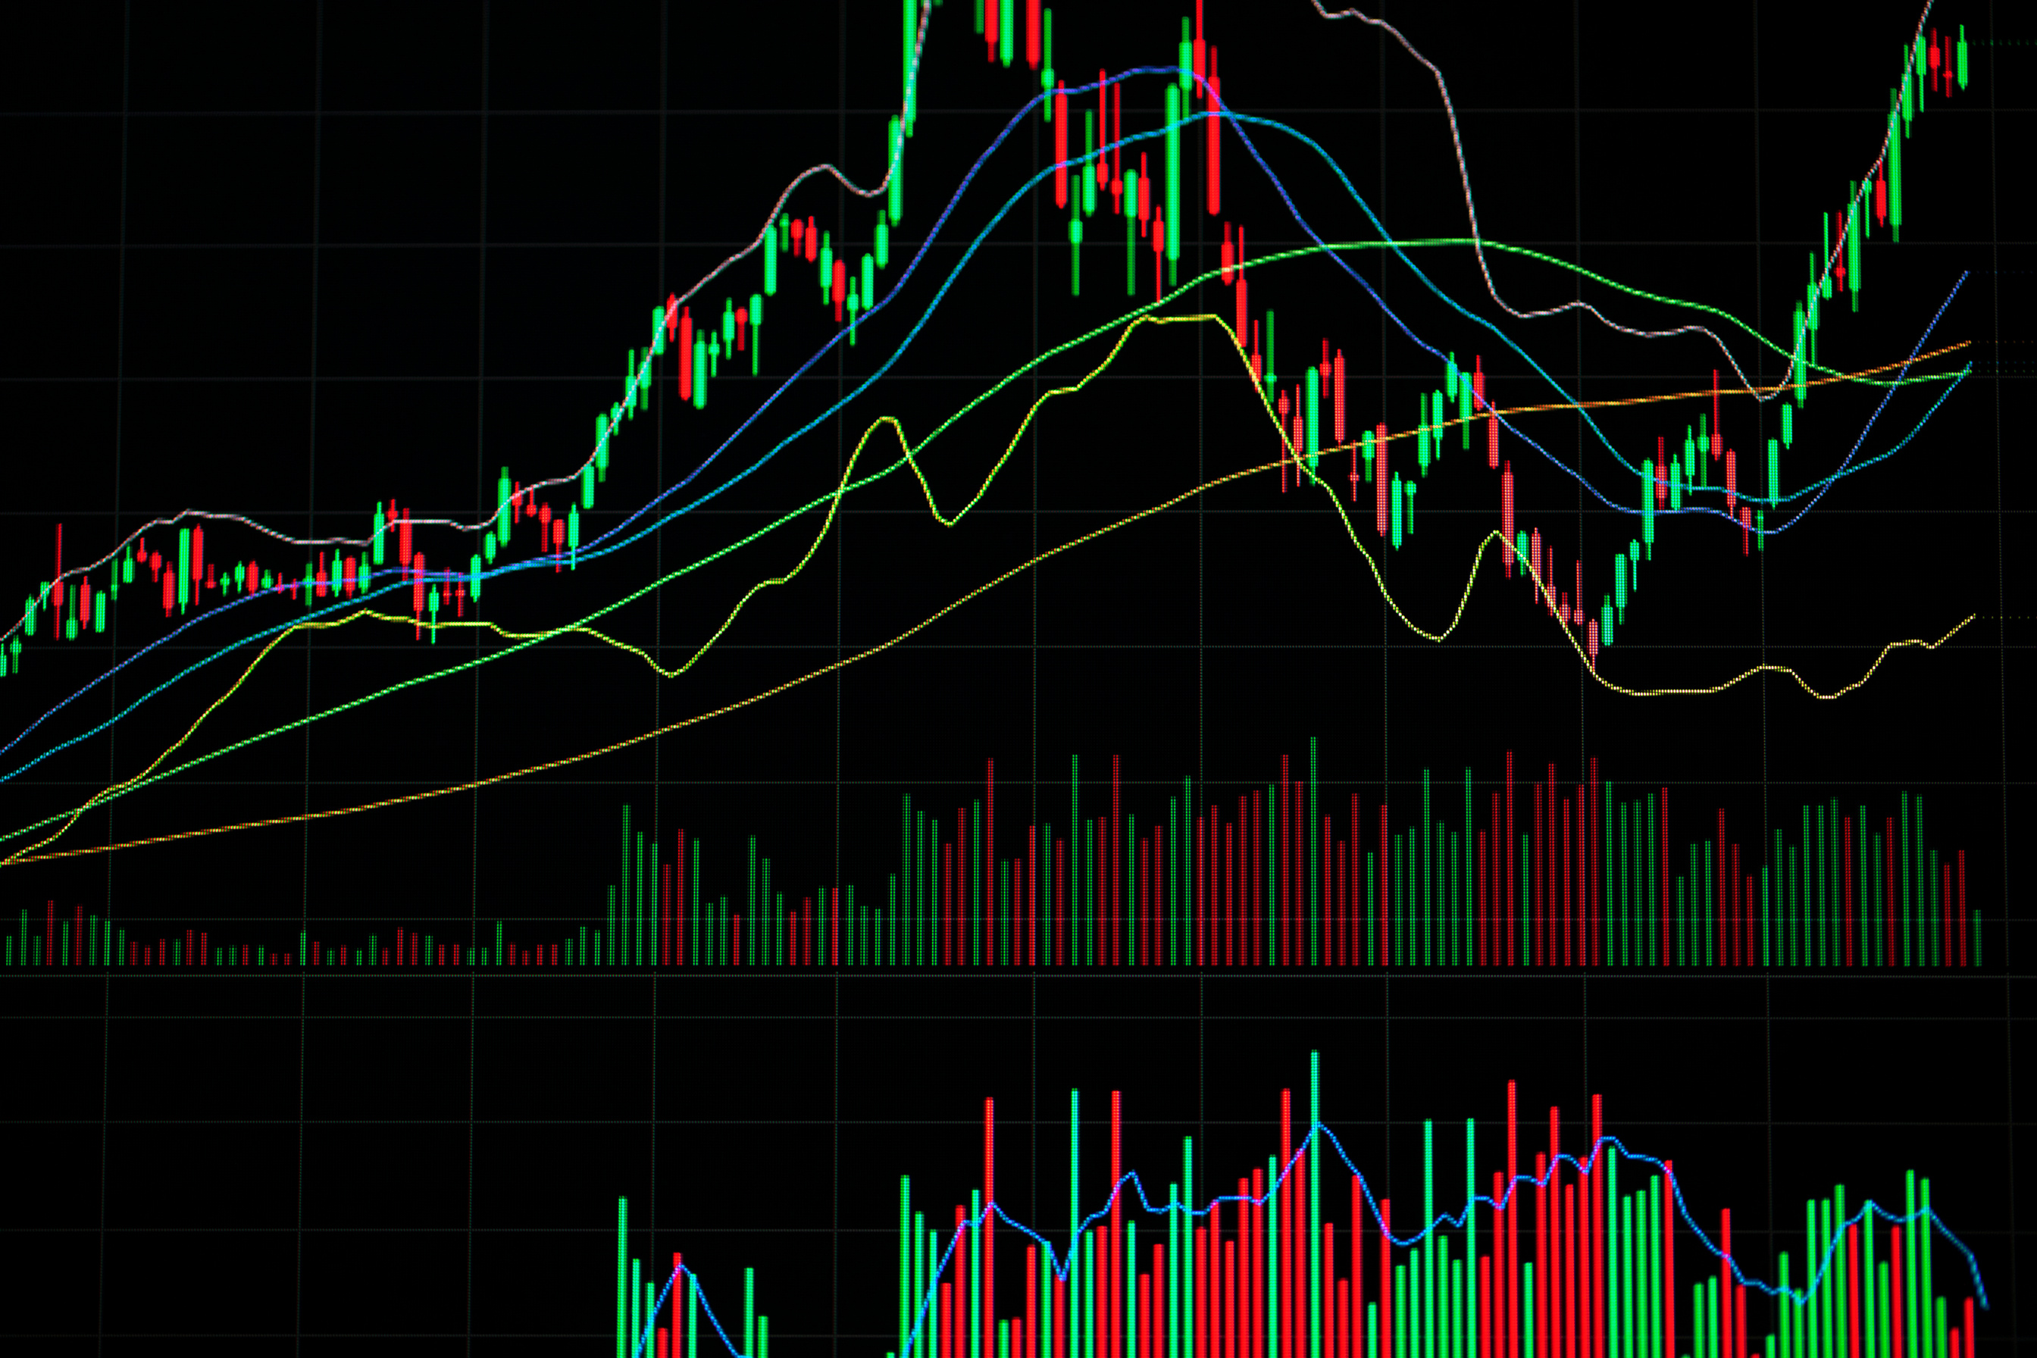

Investment Overview
ARVIND PATEL
Investment Start Year: 2019
Number of Clients: 5
Total Amount Invested: ₹ 47Lakhs
Total Present Portfolio Value: ₹1.5cr Lakhs

Slide 4

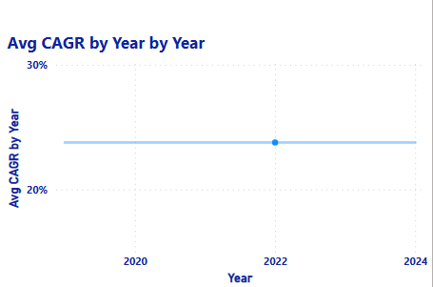
CAGR (Compound Annual Growth Rate)
ARVIND PATEL
The CAGR represents the annual growth rate of an investment over time. It helps investors compare performance across different periods.
This indicates that regardless of the year a client joined, the investments have grown at a steady and strong rate, compounding over time to maximize wealth. The 24% annual return highlights the effectiveness of asset selection, risk management, and active portfolio rebalancing to optimize gains.

Slide 5

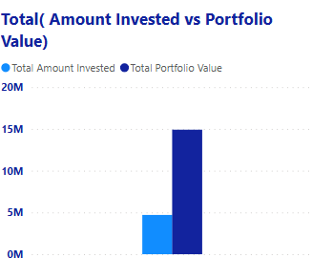
Investment Performance Comparison
ARVIND PATEL
Total Investment vs. Portfolio Value
The "Total Investment vs. Portfolio Value" metric provides a clear picture of how investments have grown over time. In this case, a total of ₹47 lakhs was invested by five clients over a period of six years, and their combined portfolio value has now grown to ₹1.5 crore.
This significant growth highlights the power of compounding returns, strategic asset allocation, and effective portfolio management. The returns generated are a result of consistent investments, market appreciation, and active fund management.

Slide 6

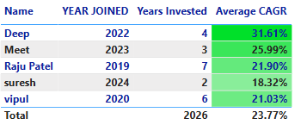
Client-Wise Performance
ARVIND PATEL
The Client-Wise Performance metric evaluates the returns generated for each individual investor while also assessing the overall performance of the portfolio management strategy. Across all clients, the portfolio has consistently delivered an average return of 23% per year.
This indicates that regardless of the year a client joined, the investments have grown at a steady and strong rate, compounding over time to maximize wealth. The 23% annual return highlights the effectiveness of asset selection, risk management, and active portfolio rebalancing to optimize gains.

Slide 7

Why Invest through PMS?
ARVIND PATEL
Traditional investment options, such as fixed deposits, bonds, and even mutual funds, typically offer a maximum return of around 18% per year. While these options provide stability and moderate growth, they often lack customization, flexibility, and active portfolio management, which are crucial for maximizing returns in dynamic market conditions.
In contrast, our Portfolio Management Service (PMS) has consistently delivered an average annual return of 24%, outperforming traditional investment methods. The higher returns are achieved through active fund management, strategic asset allocation, and personalized investment strategies tailored to each investor's risk appetite and financial goals. This performance showcases the superior growth potential of PMS over conventional investment vehicles.
Recommendations:
Investors looking for higher returns and greater control over their investments should consider Portfolio Management Services (PMS). Unlike mutual funds, where investment decisions are collective, PMS allows for personalized investment strategies, giving investors direct control over asset allocation.

Slide 8




ARVIND PATEL
Thank You
Start Your Investment Journey With Us
PMS Owner: Arvind Patel
9377640080
www.arvindpatelpms.com
arvindpatel5862@gmail.com

